Slide 1
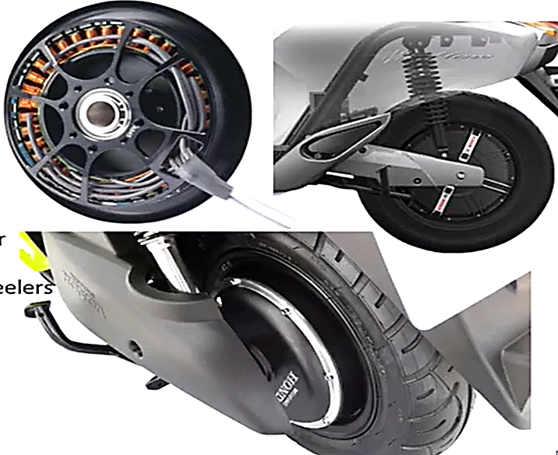
Types of BLDC Motors
1. Out-runner BLDC Motor
• Rotor is outside and stator is inside
• Also called as Hub Motor
• No external gear system
• Less bulky vehicle
• It eliminates space for mounting motor
• Preferred in electric cycle and two wheeler

